Slide 1


DATA221 Intro Machine Learning 10-Soft margin discrimination
William Trimble
Spring 2023

Slide 2
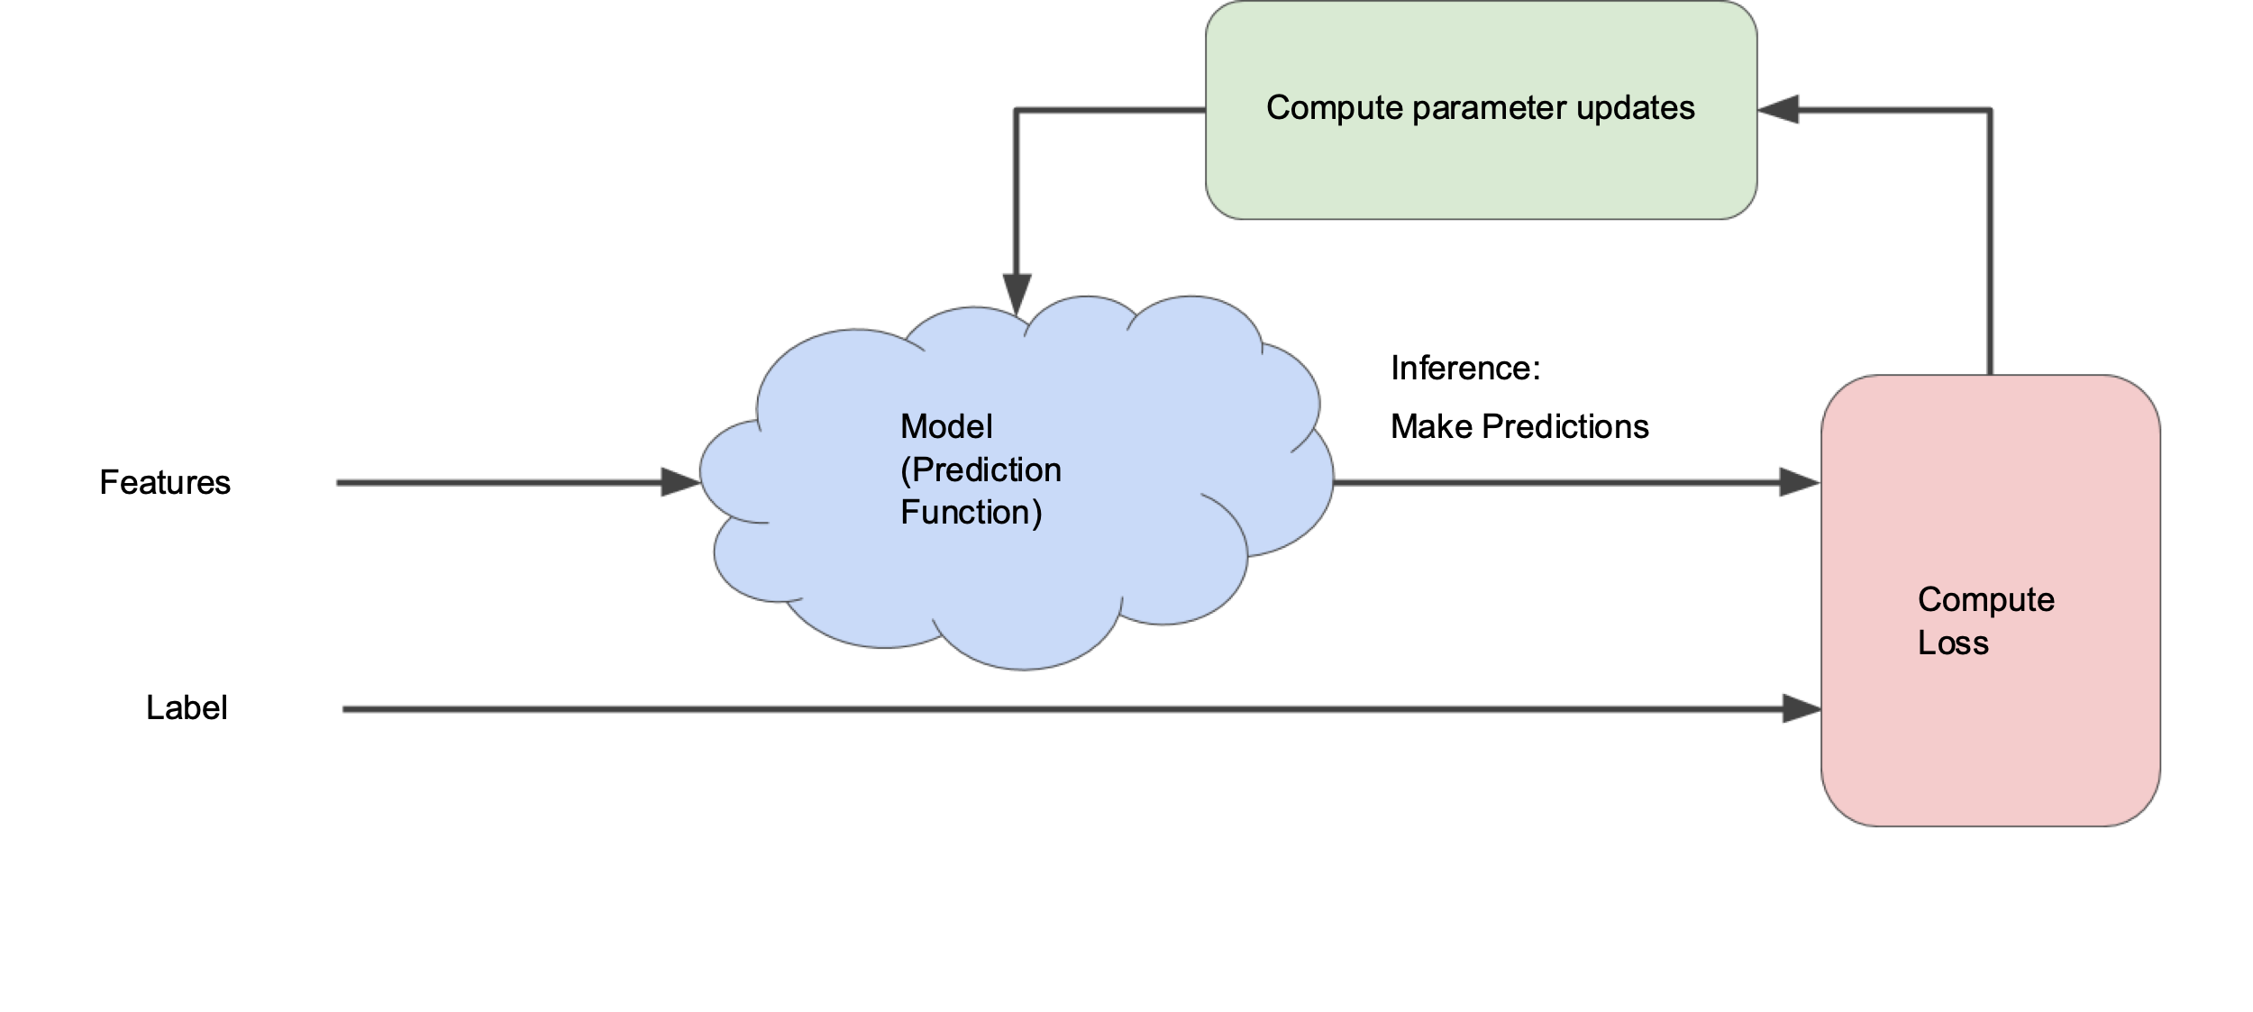
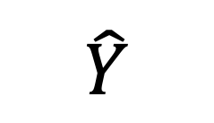
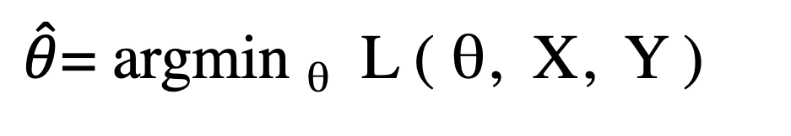
The optimization paradigm
$\hat{θ}$= argmin _{θ} L ( θ, X, Y )
θ
$$\hat{Y}$$
X
Loss
Y

Slide 3
Linear discrimination
So there were a handful of approaches for classification that divided the space of features up with straight lines:
linear regression
logistic regression
Gaussian models + shared covariance matrix
And there were a handful of methods that would allow nonlinear boundaries:
linear discrimination with kernel vectors that are nonlinear in the features
Gaussian models + different covariance matrices

Slide 4
Soft Margin Classification
Logistic regression came from statistics, and drops out of an argmax formulation.
There is another approach that conceptually comes out of engineering but uses the same machinery (argmax of a loss function that evaluates the mismatch between the model and the data) but starts from a different place (like discrete math CS vs calculus stats)
The textbooks say that it was developed in the 90s and that after some years it was found to be equivalent to classification/regression with a certain sort of loss functions.
Most of the terms in the soft margin loss function vanish; only a few remain nonzero; convenient for some problems.

Slide 5
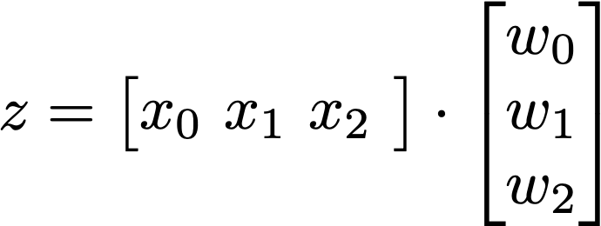
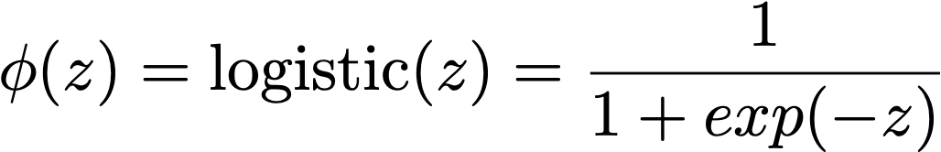
Linear on the frontend…
Nonlinear in the rear

Slide 6
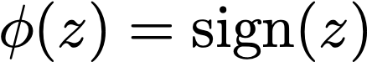
Linear on the frontend…
Nonlinear in the rear

Slide 7
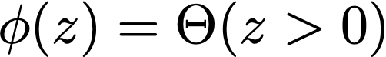
Linear on the frontend…
Nonlinear in the rear

Slide 8
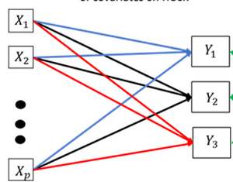
Beak length,
mass
Species
inference
X_{r}

Slide 9
Beak length,
mass
Species
inference
y = X w + b
X_{r}

Slide 10
Q
x₁
x₄
x₂
x₃
w₁
w₂
w₃
w₄
Beak length,
mass
Species
inference
n
Q
e₁^{T}
y
x₁
x₂
x₃
x₄
w₁
=
w₂
n
w₃
w₄
(n x 1)
(n x r)
(r x 1)
X_{r}

Slide 11
Q
x₁
x₄
x₂
x₃
w₁
w₂
w₃
w₄
Beak length,
mass
Species
inference
n
x₁
x₂
x₄
Q
e₁^{T}
y
x₃
w₁
=
w₂
n
w₃
w₄
(n x p)
(n x r)
(r x p)
X_{r}

Slide 12
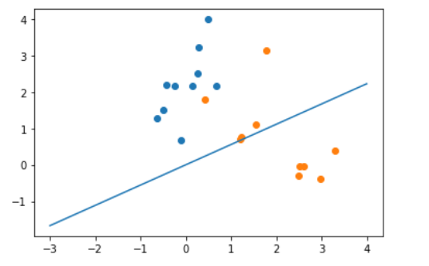
The thick line is the linear regression line.
The red line makes only 1 misclassification

Slide 13
Special case: perfectly separable features
Threshold

Slide 14
Can you find a threshold that separates the classes perfectly?
“Maximum margin” threshold maximizes the sum of the minimum distances to the decision boundary

Slide 15
Can you find a threshold that separates the classes perfectly?
Threshold?

Slide 16
Can you find a threshold that separates the classes perfectly?
“Maximum margin” threshold maximizes the sum of the minimum distances to the decision boundary
NOTE: The placement of the decision threshold depends here on just two points, not a sum over all the data. The correctly classified points have zero weight in computing the threshold.

Slide 17
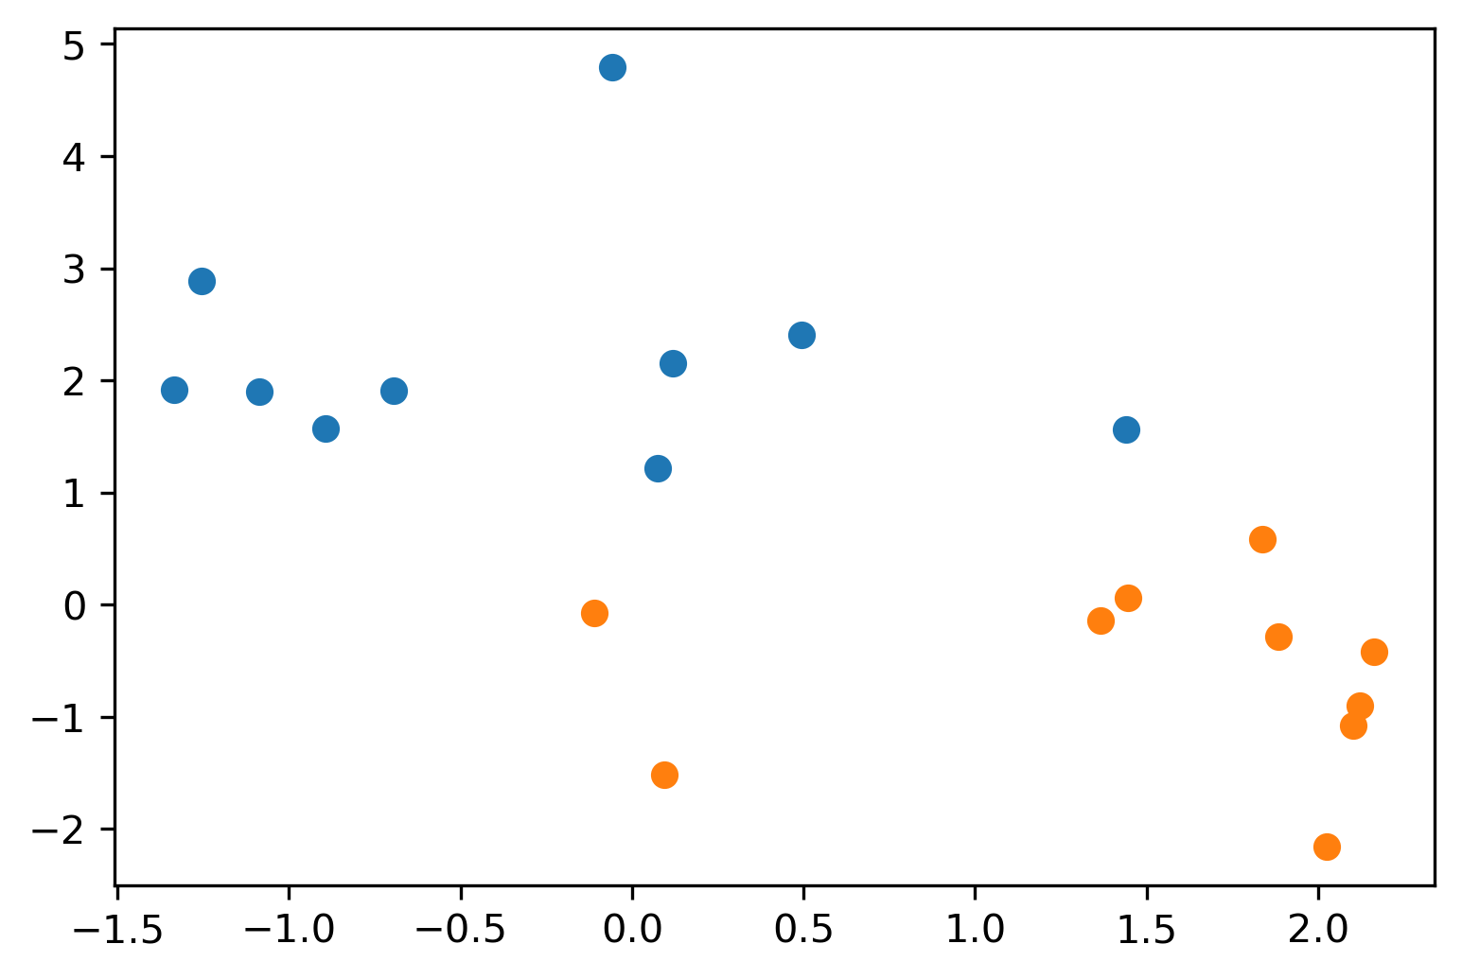
One vs. many…

Slide 19
“Maximum margin” doesn’t apply when some points are misclassified… so a compromise was found
What did the engineers come up with? A fudge factor for the loss function.

Slide 20
Parameters
Observations
N(Data) > N(Parameters)
Overdetermined
Underparameterized
Normal ”fitting”,
least-squares
or not, is like this.
ℝ ^{r}
ℝ ^{r}
ℝ ^{n}

Slide 21
Parameters
Observations
N(Data) > N(Parameters)
Overdetermined
Underparameterized
Normal ”fitting”,
least-squares
or not, is like this.
ℝ ^{r}
ℝ ^{r}
ℝ ^{n}
N(Parameters0) > N(Data)
Underdetermined
Overparameterized
ℝ ^{r}
ℝ ^{n}
ℝ ^{r}

Slide 22
“Maximum margin” doesn’t apply when some points are misclassified… so a compromise was found
What did the engineers come up with? A fudge factor for the loss function.
“Margin” is a hyperparameter that defines a band around the decision threshold.
Ignore all correctly classified points;
Permit but penalize misclassifications within the margin

Slide 23
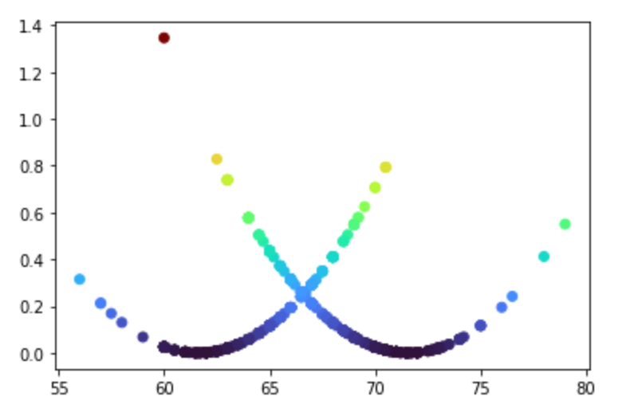
SSE loss function for Galton height data
SSE loss funciton
Height (in)

Slide 24
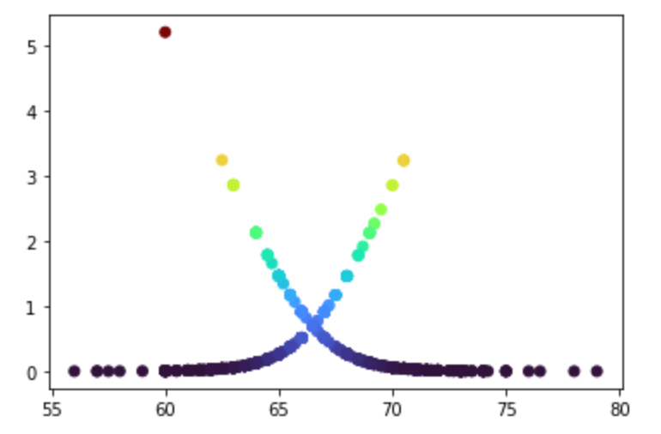
Logistic loss function on Galton height data
Logistic loss funciton
Height (in)

Slide 25
Hinge loss function
The loss function counts the absolute value of the distance to the threshold hyperplane, but only when it is on the wrong side, or within margin of the right side.
“Margin”
Threshold
How to set margin?

Slide 26
Hinge loss function
The loss function counts the absolute value of the distance to the threshold hyperplane, but only when it is on the wrong side, or within margin of the right side.
“Margin”
Threshold
Large margins look at more points.
How to set margin?

Slide 27
Parameters
Observations
N(Data) > N(Parameters)
Overdetermined
Underparameterized
Normal ”fitting”,
least-squares
or not, is like this.
ℝ ^{r}
ℝ ^{r}
ℝ ^{n}
N(Parameters0) > N(Data)
Underdetermined
Overparameterized
Iterating over n
is easier than iterating over r
ℝ ^{n}
ℝ ^{r}
ℝ ^{n}
ℝ ^{r}
Many dimensions must
be filled with information from prior / regularization

Slide 28
You worry too much about loss functions. Set threshold for maximum accuracy? Doesn’t work very well…
Threshold
Demo

